Slide 1
NUFWS Winter Skills
Laurence Cook

Slide 2
Contents
Equipment you are going to use – B2 boots, crampons, ice axes, helmets.
Planning –
‘Be Avalanche Aware’ e-learning module.
Useful websites

Slide 3
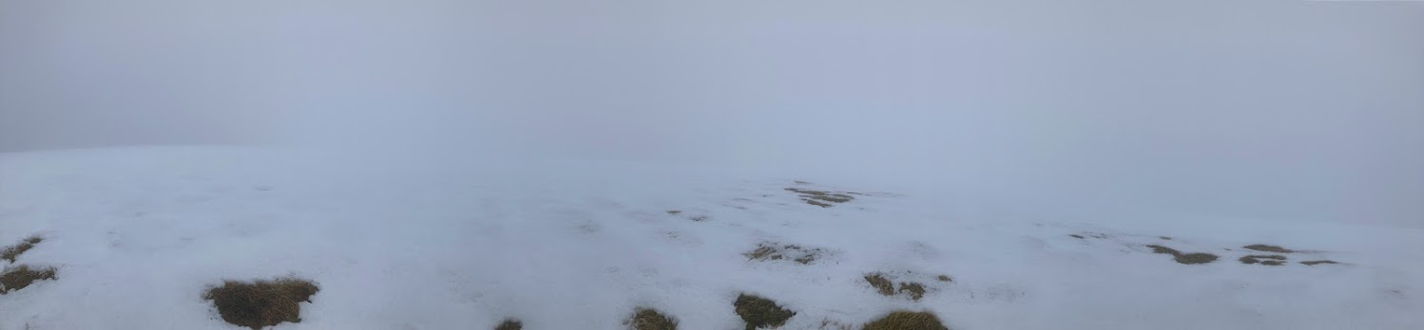
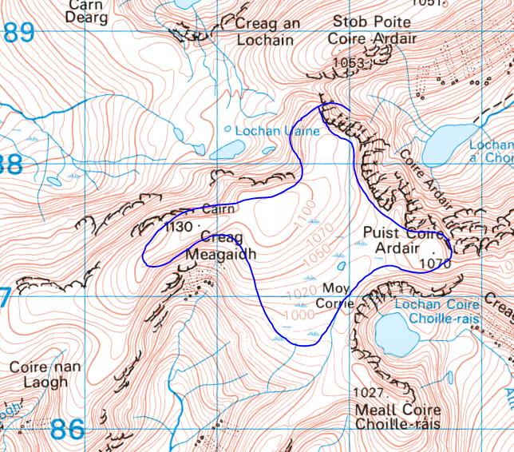
Preface
Source: Original work (me)

Slide 4
Equipment

Slide 5
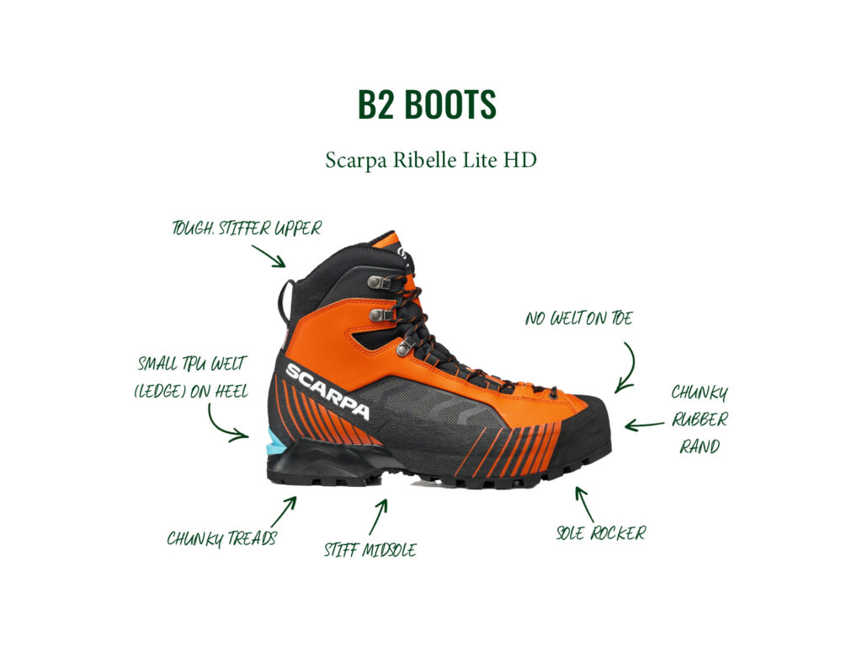
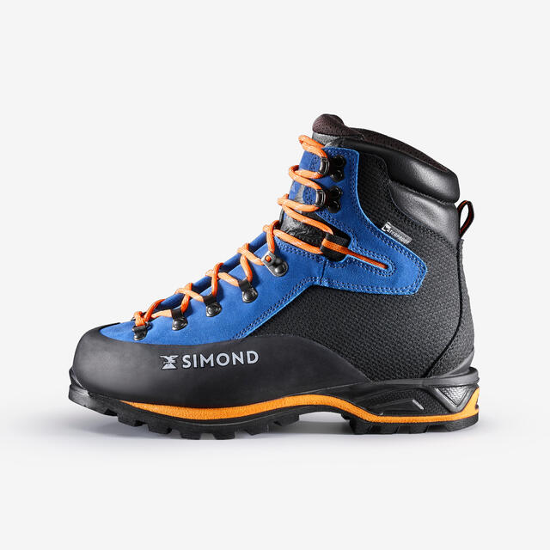
B2s
Lot stiffer than normal hiking boots.
If you get the wrong size you will get blisters.
Must be worn when using crampons.
Remember the size that fits you as we will ask on the form for the trip.
Source: Trekitt
Source: Decathlon

Slide 6













B2s (2)
There are some different techniques that B2s allow for:
Toeing in – the toe of the boot is swung hard into the snow to allow for traversing up a steep slope. The stiff sole allows for the toe to act as a pivot as the length of the boot is able to remain without simply bending.
Cutting steps – the farside flank of the boot is swung to create a step, usually done to give passage going parallel along a steep slope.
Corridor’ing – done in deep snow, a group stays in single file with the strongest walkers at the front. Each successive member of the group steps into the foot print just out of phase of the person in front, creating a ‘corridor’ so weaker members may proceed faster than they otherwise would.
Source: Original work (me)

Slide 7
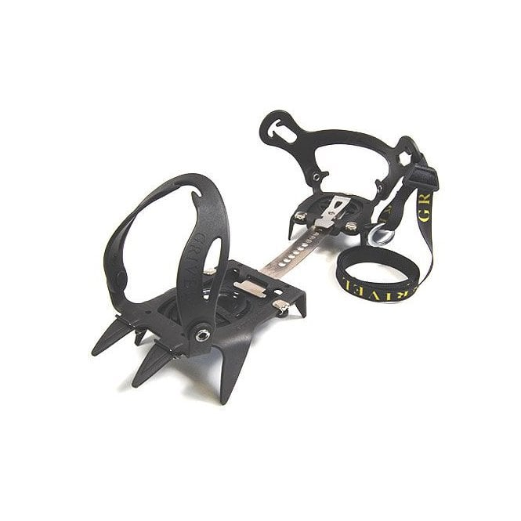
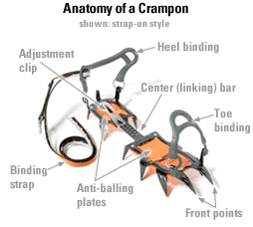
Crampons
Used to provide extra grip when traversing over snow and particularly ice.
Come in different ratings.
We use C1 rated Grivel Monte Rosa’s (below and right).
10-pointed.
Adjustable rail to fit different boot sizes.
Fitting the crampons to your boots:
Put the boot into the crampon (left/right).
The toe should poke through the front gap in the ‘Toe binding’ and the heel should sit in the ‘Heel binding’, poking out the back.
If this is not the case adjust the crampon length by pulling the ‘Adjustment clip’ up and sliding the ‘Center (linking) bar’ either backwards or forwards.
Once the boot fits snuggly, close the ‘Toe binding’ over the top of the toe of the boot and allow the heel to sit securely in the ‘Heel binding’.
Bring the ‘Binding strap’ and feed it through the top of the ‘Toe binding’ then feed it through the hole on the other side of the ‘Heel binding’, making sure to feed in through the inside and come out with the strap facing away from the boot.
Bring the strap along the tongue of the boot and feed through both rings, then turn the strap around and feed it back through just one ring. If done correctly this will keep tension and allow you to tighten the crampon around the boot.
To tighten the crampon simply pull the one outer ring away from the inner and feed the strap through.
After adjustment feed the excess length of strap through the ‘toe binding’ so as it won’t get caught on anything.
The crampon should not be able to move or jiggle once fitted correctly. Ask if unsure.
Source: Outdoor Action
Source: REI on Pinterest

Slide 8
Crampons (2)
Storage:
When you are not wearing the crampons it is advisable to do the following to prevent damage to bags:
Push the heel and toe bindings down.
Face the spikes of L and R crampons toward one another.
Put together with the L heel points facing the R toe points and vice-versa.
Wrap the adjustment straps around both of the crampons to stop them coming apart.
If you have a carrier bag or other heavier duty bag put them in this to prevent snags.
Technique:
You will be taught how to use them on the trip.
Make sure to swing your leg out to avoid the points ripping trousers.
Recommend putting gators over the top of your waterproof trousers to reduce the chance of anything catching.

Slide 9
Crampons (3)
When to use:
Crampons are sharp and thus usage on rock blunts them and reduces their efficacy.
As such only put them on when you’re imminently about to step onto ice/snow and take them off when it ends.

Slide 10
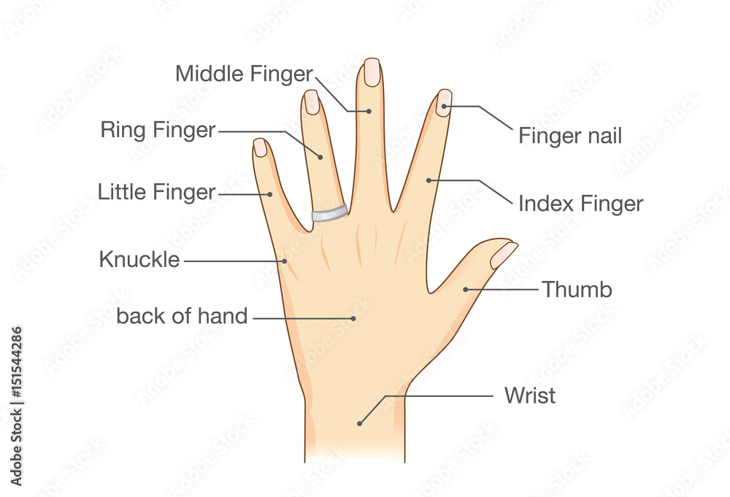
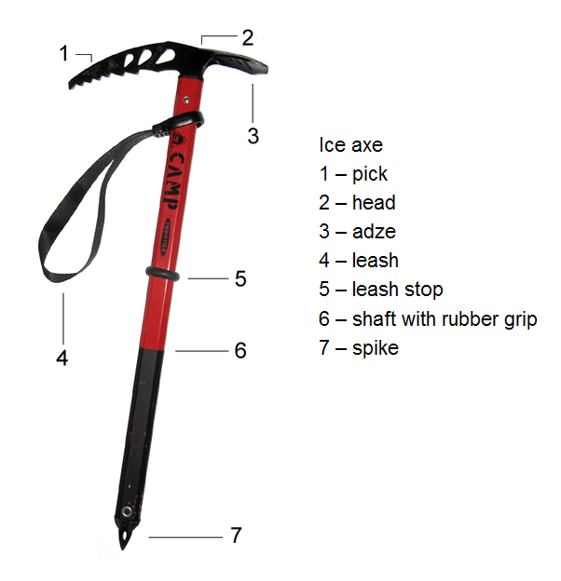
Ice axes
BMC Article
Used to aid with stability.
Self-arrest.
Always hold in uphill hand, if not on a slope hold in dominant hand.
Hold with the adze (3) facing forwards, your middle, ring and pinkie finger should grip the pick (1) from the underside, the index finger should be held straight and run down the length of the shaft (6) with the thumb on top of the adze.
Source: Adobe
Source: upadowna

Slide 11
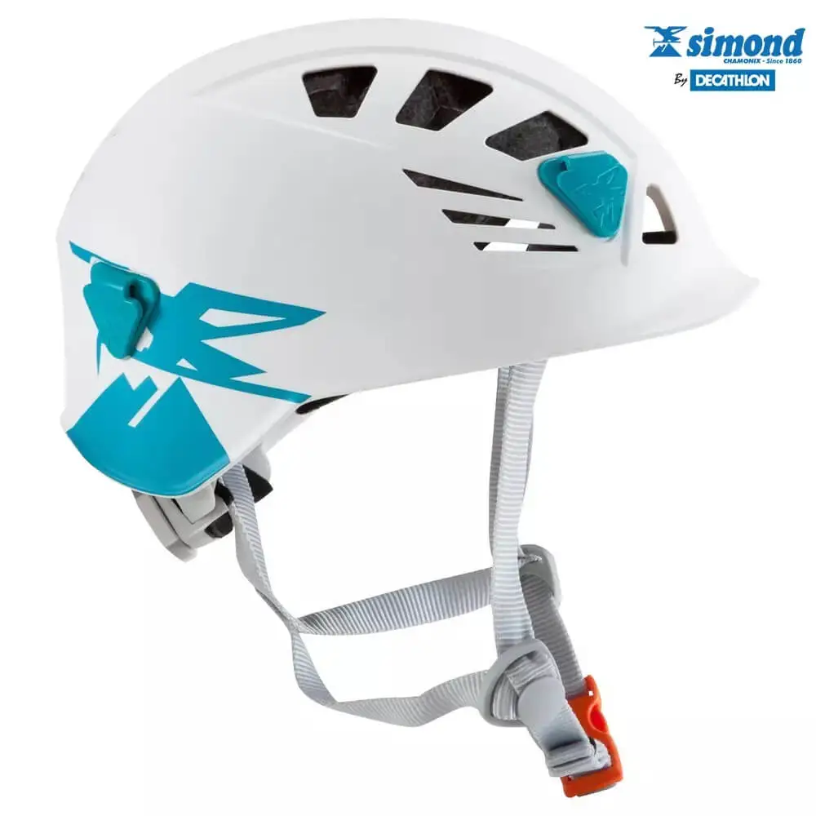
Helmet
Clip underneath the jaw
Adjustable bezzle at the back to tighten around the side of the head
Needs to be tight enough to not wobble around
Wear hat if slightly too big
Source: Alpinist

Slide 12
Avalanche awareness and the forecast

Slide 13
90% of avalanche victims cause their own avalanches. Awareness and good planning are the best ways to avoid getting caught out. As part of a group it is important that all members have an understanding of what the key features are and to speak up if they think something is wrong. The following slides are focused on the planning process for walks in winter conditions – whilst not strictly relevant for this trip, we hope this will give you a good background to developing confidence to plan your own walks in such conditions. All preparations and contingencies that apply in other seasons apply here, the following is in addition to these.

Slide 14
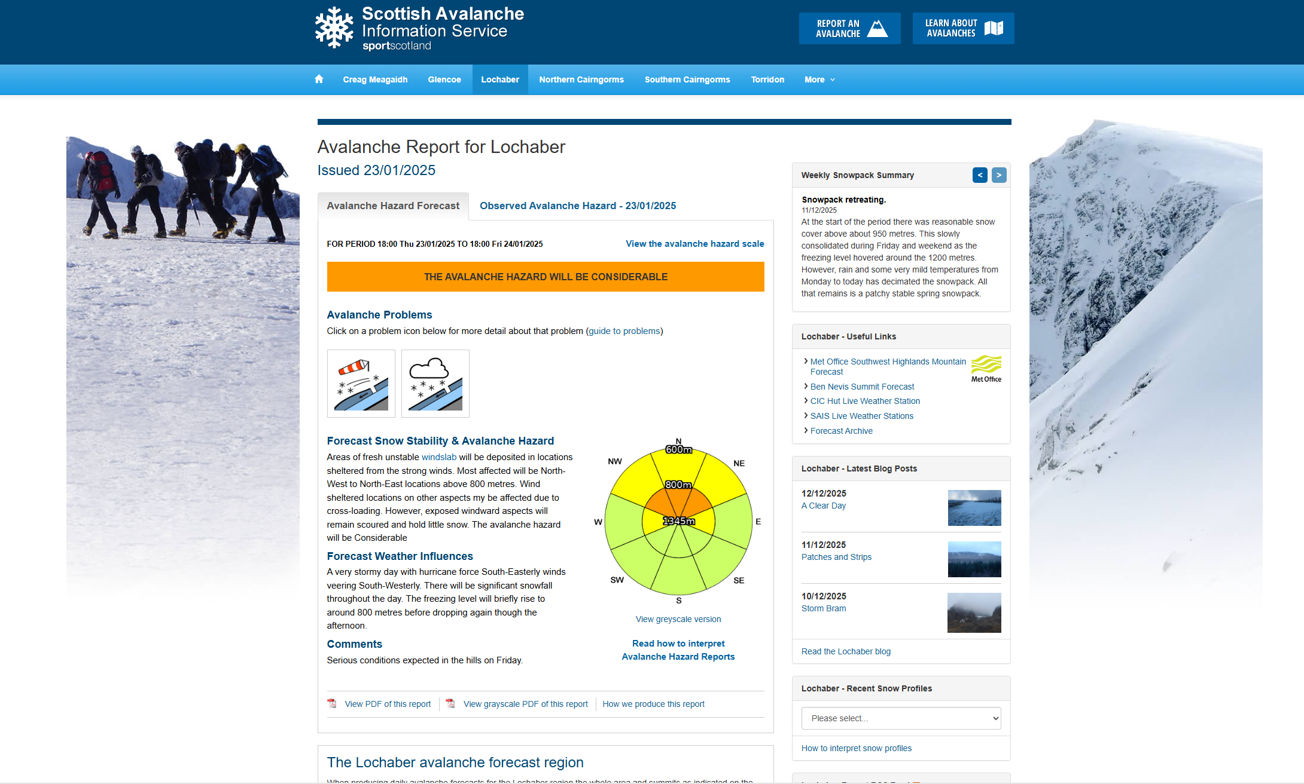

Slide 15
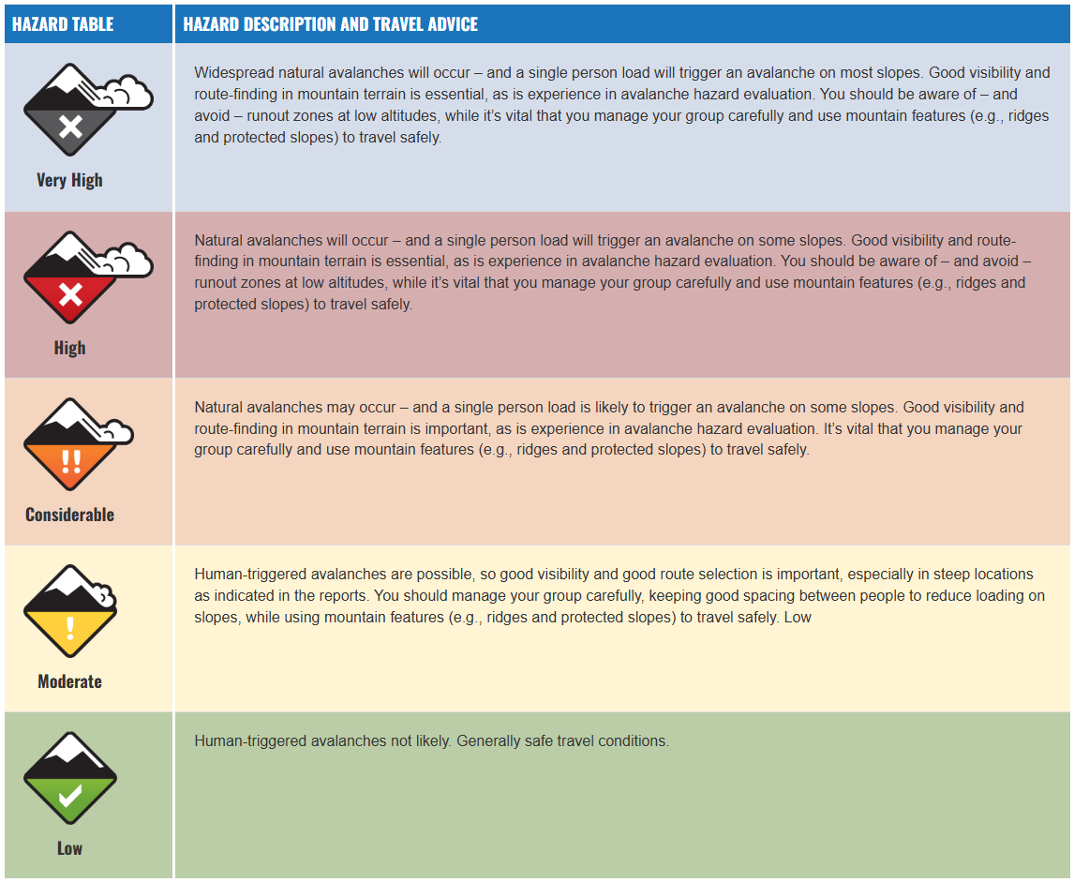
The hazard table for avalanche risk.
Source: SAIS website

Slide 16
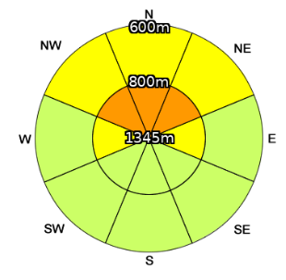
Hazard compass

Slide 17
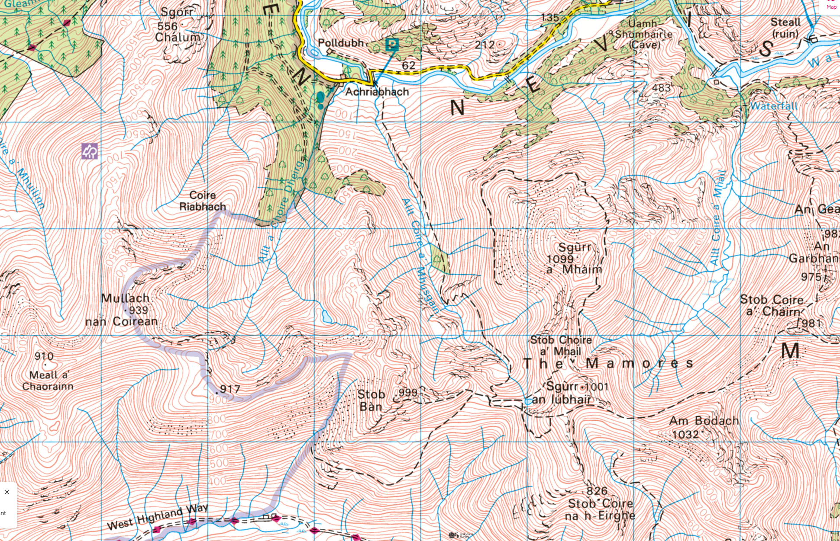

Slide 18
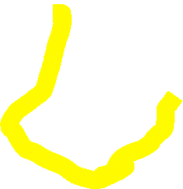


























Slide 19
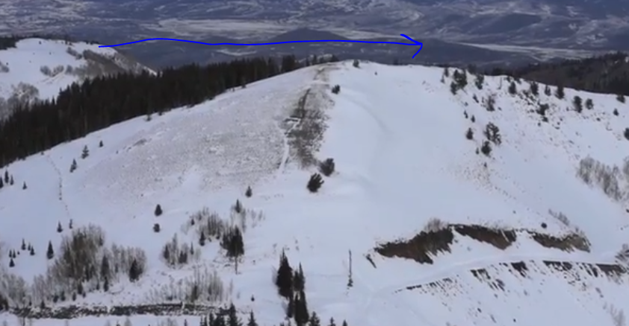
Key points
Wind direction (note a SW wind direction means it is blowing from SW to NE) – the wind will blow snow around (wind drifted snow) when wind speed is >15mph (24kph). This will deposit on leeward slopes. https://youtu.be/-m8kPGOxTHA?si=WFZZILUWHGtacn2n&t=7
Terrain aspect – what bearing is the corrie/slope on? Southern aspects get more hours of sunlight, Northern may not get any at all. More snow gathers in/on Northern aspects.
Slope angle – avalanches tend to start on slopes with angles between 25-45deg, their tracks on 15-25deg and run out at >15deg. Convex v concave.
Slope altitude and freezing level – terrain below the freezing level will not have snow fall on it, must leave margins of error when planning routes however.
Source: Bruce Tremper, Utah Avalanche Center

Slide 20
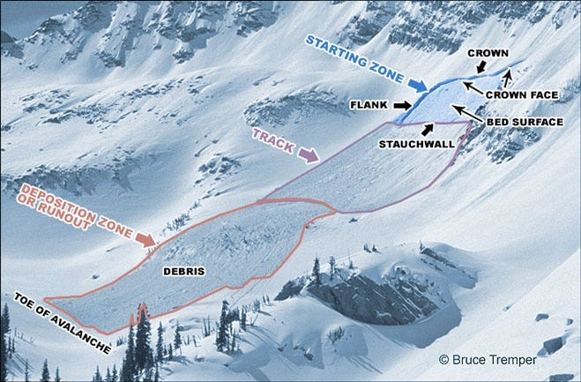

Slide 21
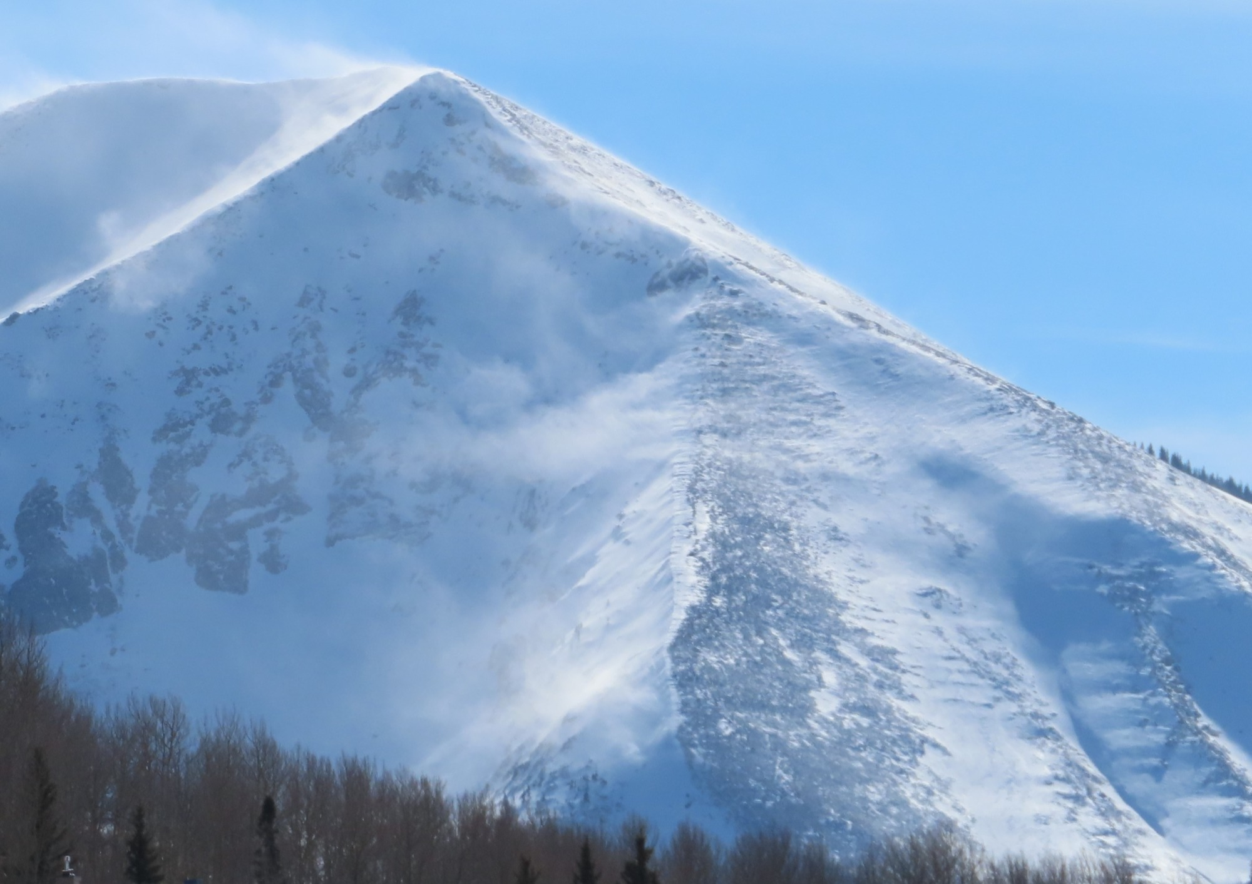
Example of cross-loading:
The wind is wrapping around from right to left, depositing snow on the leeward slope in the action of cross-loading (named as it is ‘loading’ the leeward slope).
Source: Crested Butte Avalanche Center

Slide 22
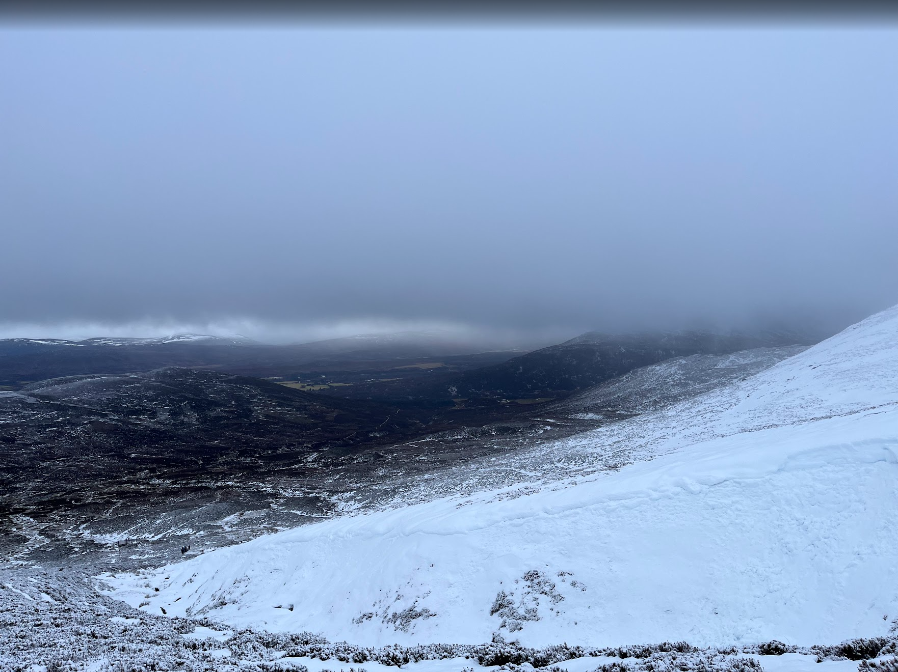
Source: Rebecca Rawlinson, Winter Skills Trip 2024

Slide 23
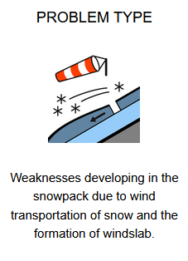
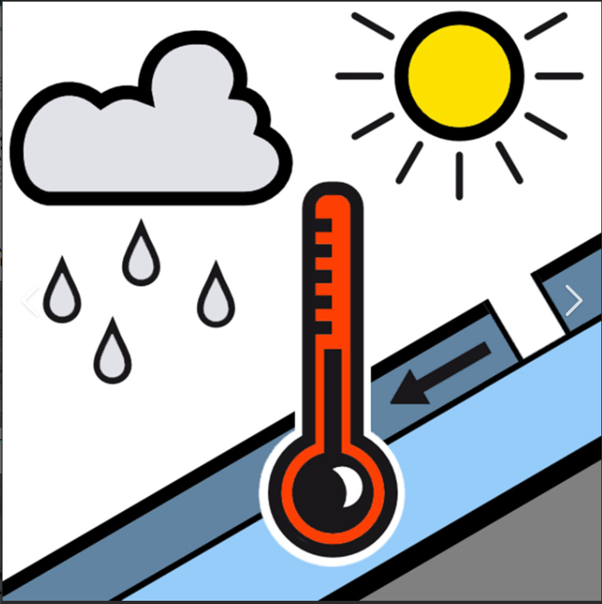
Examples of snowpack instability symbols used on SAIS:
Source: Lochaber - Scottish Avalanche Information Service
Source: wet snow instabilities eur avalanche symbol - Search
Wet snow instabilities:
Snow thaws
Liquid water creates weakening of the snow pack layer
Affects any existing snow pack above the freezing level
Snow that has not yet been subject to thawing or areas with existing weaknesses are particularly sensitive
Rain is not required but will rapidly elevate the likelihood of avalanches
Described as ‘wet slab’ or ‘loose snow’ avalanches
Wind drifted snow:
Common in >15mph winds
Creates drifting snow
Accumulates on leeward slopes
Formation of windslabs
Does not need to actively be snowing to form – previously fallen snow is blown around to create windslabs.

Slide 24
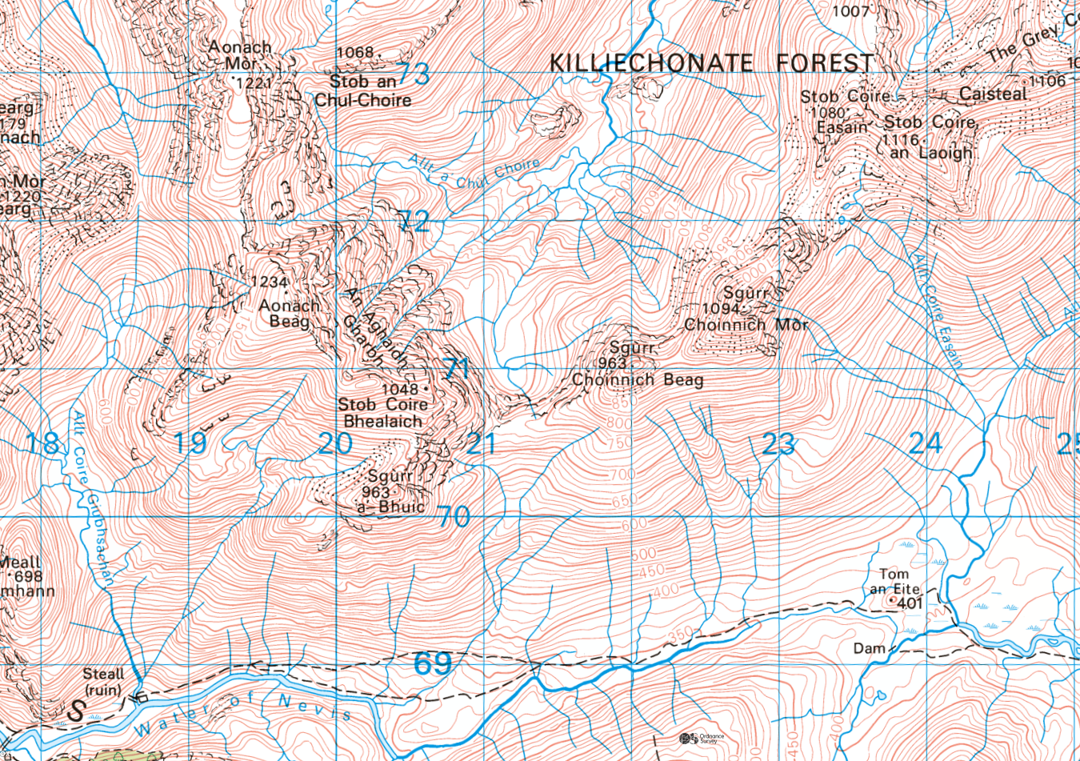
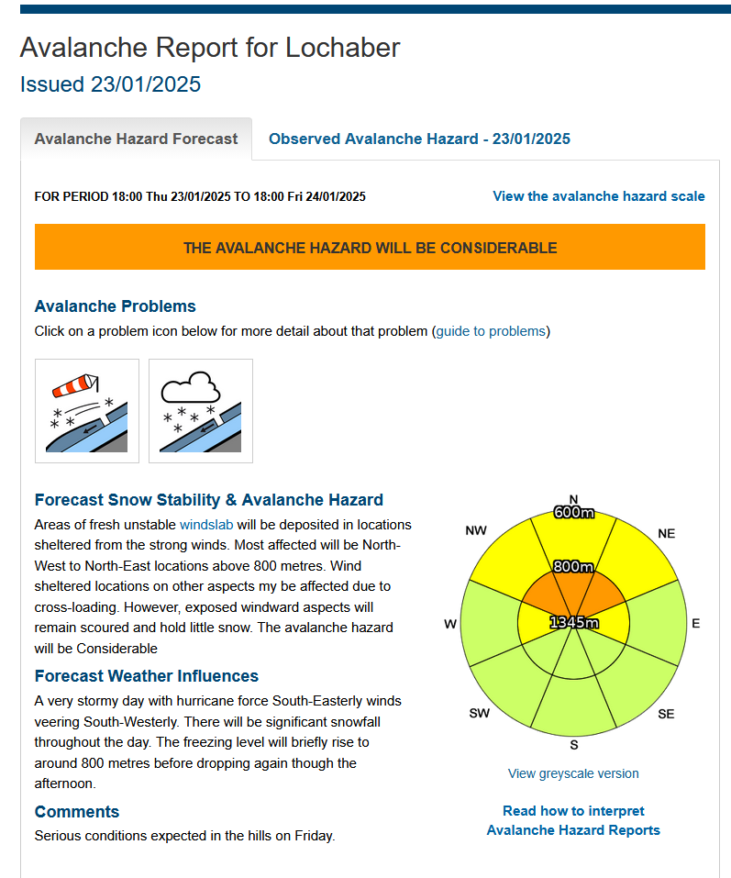


Slide 25







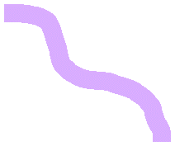











Slide 26
Remarks
Huge amount of information available on the study of snow and how it affects walking conditions.
We have only covered a tiny part of a very detailed topic.
Information you find can be useful but only if used correctly.
Like with all weather reports and conditions do not take as gospel – if the conditions are changing and your plan is no longer viable use contingencies and common sense.

Slide 27
‘Be Avalanche Aware’ e-learning module
Few videos to go through in your own time (must be done if coming on the trip).
Have a go at the practise questions to test your understanding.
Useful for people wanting to lead their own walks in winter conditions.

Slide 28
Useful websites/resources
Scottish Avalanche Information Service
Useful document on SAIS on interpreting avalanche reports
Other SAIS resources
Mountain Weather Information Service
Mountain weather forecast (Met Office)

